Slide 1
Managing
Project
Based
Classroom
Xuenian LENG
Beths Grammar School
Haiyan YIN
UCL Academy

Slide 2
Authentic Challenge
- Provides personalized and differentiated learning experiences which link to a real purpose, scenario or outcome.

Slide 3
Project based learning
Set the outcome before learning;
Link it to real life scenario;
Link it to China, culture and social issues;
Plan for stages and scaffold and model it for students;
Evaluate and improve after learning at each stage;
Make the outcome a big celebration;

Slide 4
Examples:
Places/location/rooms of houses (Y9):
Previous learning: sports, hobby, some relevant adjectives, furniture
places/location:
Link: dating相亲
Content: 1). Date location
learning: names of places; what you can do; give reasons; persuasive language (因为…而且…再说…)
focus: speaking (role play-ask someone out for a date)
aflet of the town & role play)

Slide 5
Examples:
Places/location/rooms of houses (Y9):
Previous learning: sports, hobby, some relevant adjectives, furniture
places/location:
Link: dating相亲
Content: 2). Going for a date
learning: location words; describe where the place is; ask and give directions; choose the best date location and give reasons.
focus: writing & speaking (leaflet of the town & role play)

Slide 6
Examples:
Places/location/rooms of houses (Y9):
Previous learning: sports, hobby, some relevant adjectives, furniture
places/location:
Link: dating相亲
Content: 3). Weekend plan
learning: future time; past time; make a future plan; give reasons using persuasive language; reply to invitation with either agree or rejection;
focus: writing (letter to the date with weekend plan; reply from the date)

Slide 7
Examples:
Places/location/rooms of houses (Y9):
Previous learning: sports, hobby, some relevant adjectives, furniture
Rooms of houses:
Link: dating相亲
Content: 4). Buying/selling a house
learning: rooms of a house; relevant adjectives; introduce丈母娘; watch 非诚勿扰; discussion about the different view on marriage between East and West; language of politeness.
focus: writing & speaking (leaflet for estate agency; buying/selling a house)

Slide 8
Examples:
Celebration:
Collect and produce a booklet of their town design and description;
Collect and produce a booklet of their house design and description;
Estate agent wins commissions – school reward system plus a bag of chocolate, future possible trips.
Support:
Writing frame with sentence starters & grade description;
Use reading materials to support speaking;
Model speaking

Slide 9
Requires:
Termly planning;
Plan together;
Link with previous learning – pragmatic rehearsal;
Make assessment clear and fun;
Success criteria and evaluation through learning;
Spread the workload;

Slide 10
Topics:
Food& drink
Furniture
Personality/appearance
Personal information
Animal
Film/media/celebrity
Weather
Remember/recognise new characters
Your turn
Topic – link with previous learning – link with culture – outcome activity – success criteria

Slide 11
1
Set up
3 Reflect
2 Wording
https://www.youtube.com/watch?v=KaeNSYJvrn0&index=3&list=PLc69xcObODr-Aop3AZyBazAdlD7S_vIBQ

Slide 12
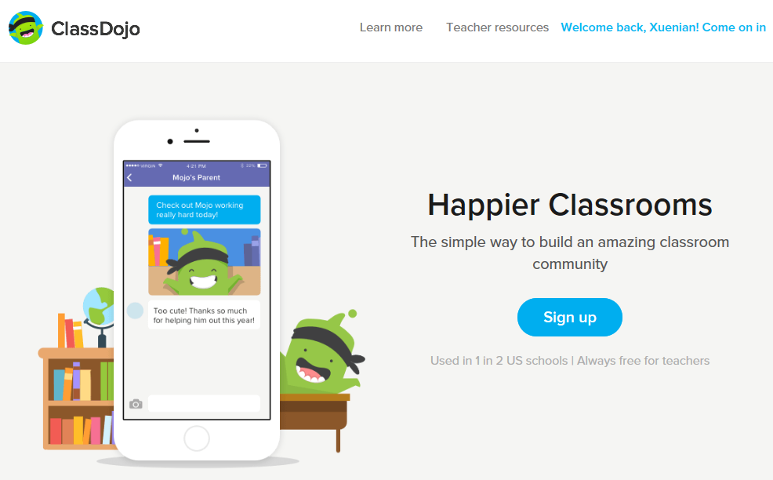
1/3 Set Up
https://www.classdojo.com/en-gb/?redirect=true

Slide 13
2/3 Wording

Slide 14
Our Project:
Role play.
4 teams playing 4 difficult child.
KATHARINE:
What does the student want? What do we want? How?

Slide 15
Our Project:
Role play.
4 teams playing 4 difficult child.
James:
What does the student want? What do we want? How?

Slide 16
Our Project:
Role play.
4 teams playing 4 difficult child.
Xiaoming:
What does the student want? What do we want? How?

Slide 17
Our Project:
Role play.
4 teams playing 4 difficult child.
Philippa:
What does the student want? What do we want? How?

Slide 18
STUDENT
A Student want to learn
B Student will learn
C Student can learn
SCHOOL
A Clear consistent policy
B You are well supported when required
C You are on your own
What’s the best way for you?
3/3 Reflect

